Slide 1
An Introduction to Description Logics 1. Syntax and Semantics
G. Falquet

Slide 2
Contents
Individuals, classes and properties
Class constructors
Ontologies
Reasoning

Slide 3
The world according to DL
There are individuals
Individuals may be interconnected through roles
Individuals belong to concepts
Similar to RDF/S (resources, properties, classes)
But different
individuals, classes, and roles are disjoint
a class may not be an instance of another class
an individual may not have instances

Slide 4
DL languages
a family of logical languages with different
class constructors
role constructors
aims
formalize the knowledge representation languages of the 80-90's (CLASSIC, KL-ONE, semantic networks, …)
decidable
there is an algorithm to check the consistency of any set of formulas
⇒ not as expressive as First order logic

Slide 5

$𝒜ℒ𝒞$ – concept constructors
Start with a vocabulary of concept names (N_{C}), role names (N_{R}) and individual names (N_{O})
Concept expressions may be
the top concept (everything): ⟙
the bottom (impossible) concept: ⟘
a concept name: A
a conjunction of concepts: C ⊓ D
a disjunction: C ⊔ D
a complement: ¬ C
an existential restriction: ∃ R.C
a universal restriction: ∀ R.C

Slide 6
Manchester notation
class name
Building
conjunction
Student and Employee
disjunction
Man or Woman
complement
not Student
existential restriction
child some Student
universal restriction
child only Student

Slide 7

Semantics of $𝒜ℒ𝒞$
An interpretations I consists of
a domain ∆^{I}
an interpretation function I such that maps:
every individual name a to an element I(a)∈ ∆^{I}
every concept to a subset of ∆^{I}
every role to a binary relation on ∆^{I} (a subset of ∆^{I}×∆^{I})
The semantics of non atomic concepts and roles is (recursively) defined in terms of atomic concept and role interpretations.

Slide 8
Semantics of concept expressions
I(⟘) = ø
I(⟙) = ∆^{I}
I(C ⊓ D) = I(C ) ∩ I(D )
I(C ⊔ D) = I(C ) ∪ I(D )
I(¬C) = ∆^{I} – I(C )
I(∃R.C) = {x ∈ ∆^{I} : ∃y: (x, y) ∈ I(R) and y ∈ I(C )}
I(∀R.C) = {x ∈ ∆^{I} : ∀y: (x, y) ∈ I(R) ⇒ y ∈ I(C )}

Slide 9
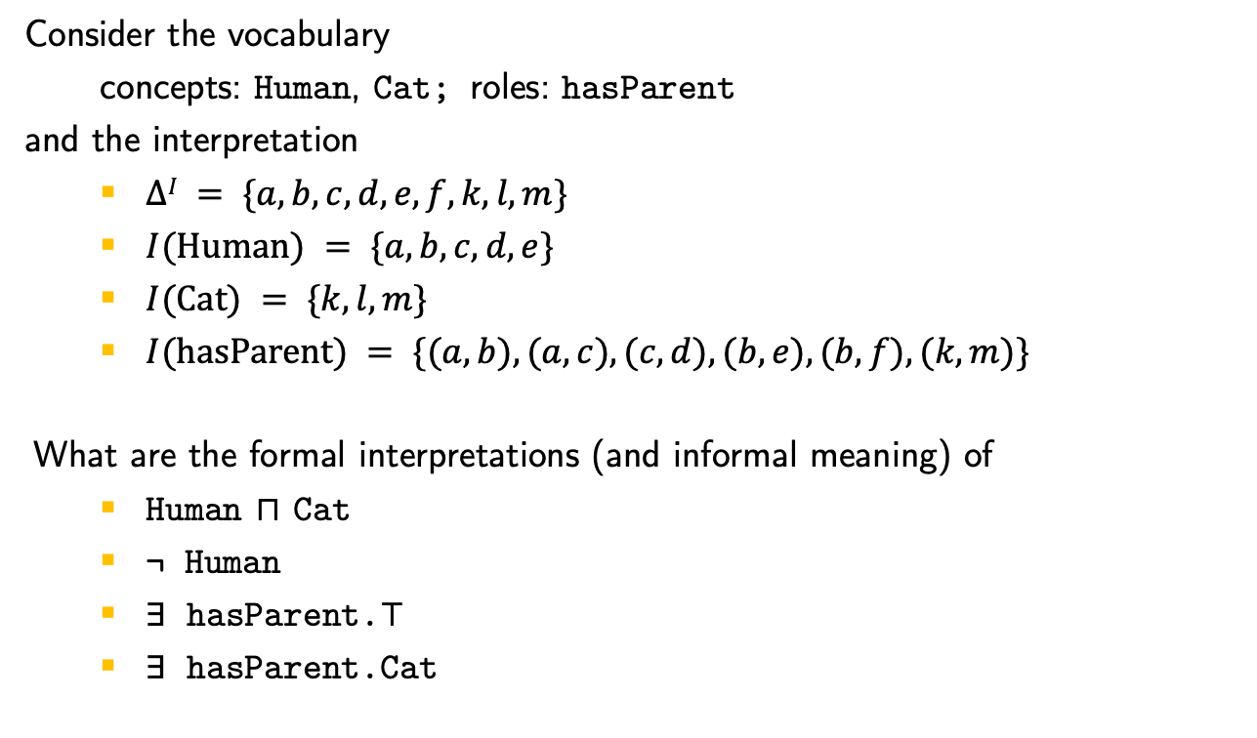
Exercise
Consider the vocabulary
concepts: Human, Cat; roles: hasParent
and the interpretation
$∆I = \{a, b, c, d, e, f, k, l, m\}$
$I(Human) = \{a, b, c, d, e\}$
$I(Cat) = \{k, l, m\}$
$I(hasParent) = \{(a, b), (a, c), (c, d), (b, e), (b, f), (k, m)\}$
What are the formal interpretations (and informal meaning) of
Human ⊓ Cat
¬ Human
∃ hasParent.⊤
∃ hasParent.Cat

Slide 10
Exercise (cont.)
If
∆^{I} = {a, b, c, d, e, f}
I(Human) = {a, b, c, d, e}
I(Cat) = {k, l, m}
I(hasParent) = {(a, b), (a, c), (c, d), (b, e), (b, f), (k, m)}
what are the interpretations of
∀.hasParent.Cat
∃ hasParent.⊤ ⊓ ∀.hasParent.Cat
∃ hasParent.(∃ hasParent.Human)
∃ hasParent.(∀ hasParent.⊥)

Slide 11
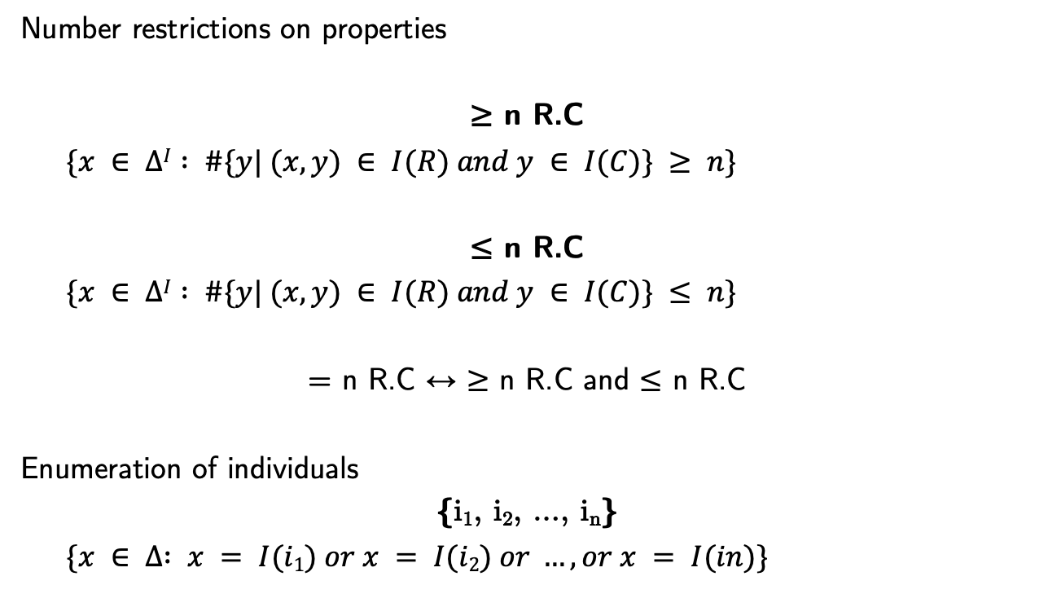

More class constructors ($𝒜ℒ𝒞𝒪𝒬$)
Number restrictions on properties
≥ n R.C
$\{x ∈ ∆I : \#\{y| (x, y) ∈ I(R) and y ∈ I(C)\} ≥ n\}$
≤ n R.C
$\{x ∈ ∆I : \#\{y| (x, y) ∈ I(R) and y ∈ I(C)\} ≤ n\}$
= n R.C ↔︎ ≥ n R.C and ≤ n R.C
Enumeration of individuals
{i₁, i₂, ..., i_{n}}
$\{x ∈ ∆ : x = I(i1) or x = I(i2) or …, or x = I(in)\}$

Slide 12
DL Knowledge Base
Vocabulary:
class names, property names, individual names
Terminological axioms (TBox):
provide class definitions and relationships between classes
Role axioms (RBox):
about roles
Assertional axioms (ABox):
about individuals

Slide 13
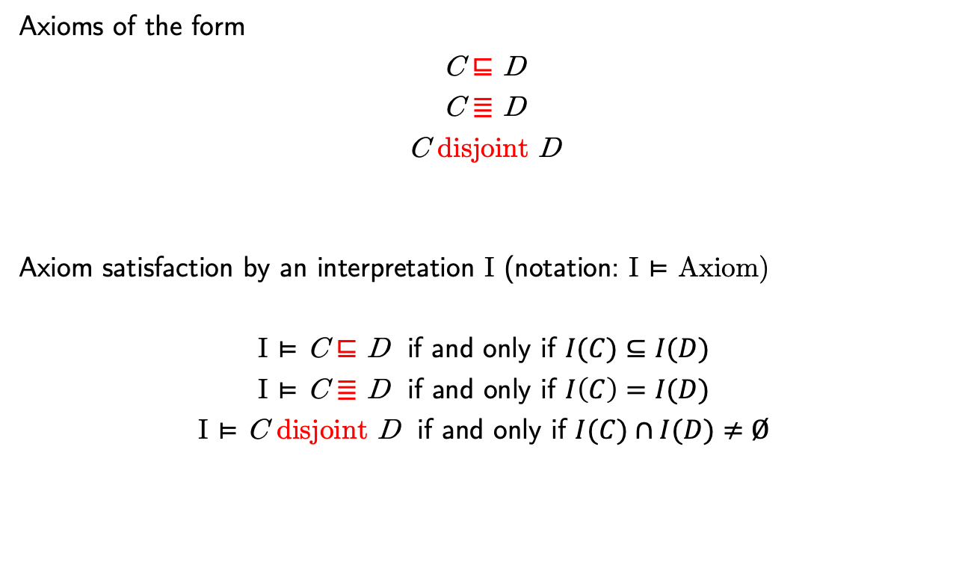
Terminological Axioms (TBox)
Axioms of the form
C ⊑ D
C ≣ D
C disjoint D
Axiom satisfaction by an interpretation I (notation: I ⊨ Axiom)
I ⊨ C ⊑ D if and only if $I(C)⊆I(D)$
I ⊨ C ≣ D if and only if $I\left(C\right)=I(D)$
I ⊨ C disjoint D if and only if $I(C)∩I(D)≠Ø$

Slide 14
Exercises
Find an interpretation I of the vocabulary
Cat, Mammal, Human (concept names),
hasParent (role names),
felix, bob, alice (individual names)
that has ∆^{I}={a, b, c, d, e, f} and satisfies the axioms
Cat ⊑ Mammal
Human ⊑ Mammal
Human ⊑ ∀ hasParent.Human
{bob, alice} ⊑ Human
{felix} ⊑ Cat
Cat ⊑ ∃ hasParent.⊤
⊤ ⊑ Mammal

Slide 15
Axioms on roles (RBox) (ALCHOQ)
P ⊑ R
if a is linked to b through P
then a is linked to b through R
I ⊨ P ⊑ R if and only if I(P) ⊆ I(R)
Examples
mother ⊑ parent
primaryFunction ⊑ function

Slide 16
Axioms on roles: property chains
R₁ ⚬ R₂ ⚬ ... ⚬ R_{n} ⊑ P
if a is linked to b through a property chain R₁ ⚬ R₂ ⚬ ... ⚬ R_{n}
then a is linked to b through P
I ⊨ R₁ ⚬ R₂ ⚬ ... ⚬ R_{n} ⊑ P
if and only if
∀y₀, y₁, ...y_{n} : (y₀, y₁) ∈ I(R₁), ..., (y_{n-1}, y_{n}) ∈ I(R_{n}) → (y₀, y_{n}) ∈ I(P)
Examples
parent o parent ⊑ grandParent
parent o parent o child o child ⊑ cousinOrSiblingOrSelf

Slide 17
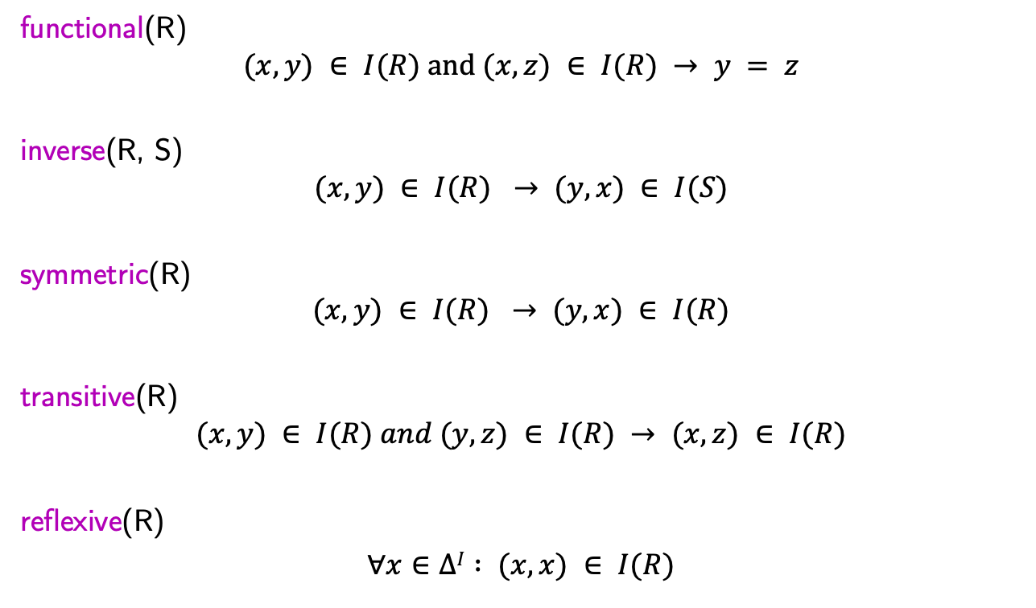
More axioms on roles
functional(R)
$$(x, y) ∈ I(R) and (x, z) ∈ I(R) → y = z$$
inverse(R, S)
$$(x, y) ∈ I(R) → (y, x) ∈ I(S)$$
symmetric(R)
$$(x, y) ∈ I(R) → (y, x) ∈ I(R)$$
transitive(R)
$$(x, y) ∈ I(R) and (y, z) ∈ I(R) → (x, z) ∈ I(R)$$
reflexive(R)
$∀x∈ΔI : (x, x) ∈ I(R)$

Slide 18
Examples
functional(biologicalMother)
inverse(mother, child)
symmetric(friend)
transitive(before)
reflexive(knows)

Slide 19
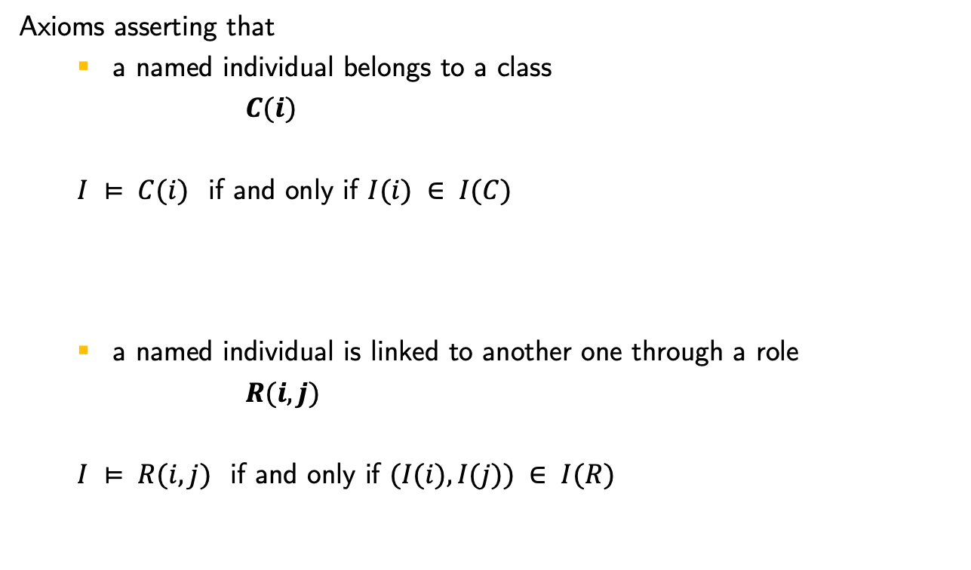
Assertions on individuals (ABox)
Axioms asserting that
a named individual belongs to a class
$C(i)$
$I ⊨ C(i)$ if and only if $I(i) ∈ I(C)$
a named individual is linked to another one through a role
$R(i, j)$
$I ⊨ R(i, j)$ if and only if $(I(i), I(j)) ∈ I(R)$

Slide 20
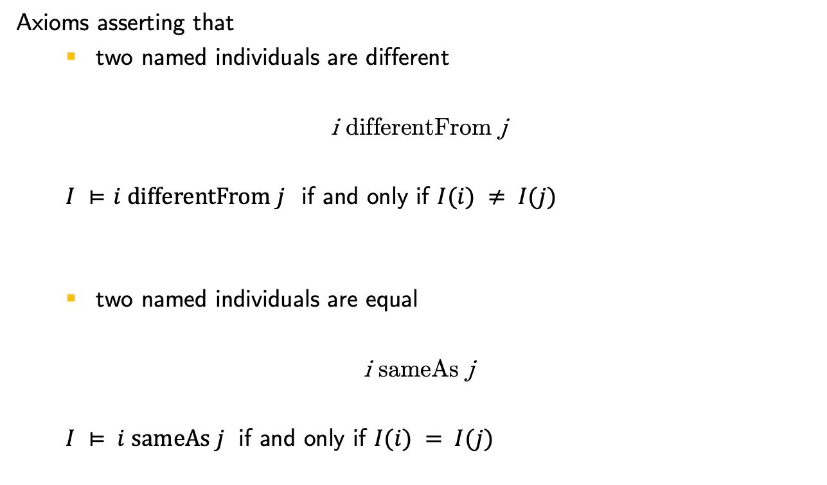
Assertions on individuals (ABox)
Axioms asserting that
two named individuals are different
i differentFrom j
$I ⊨$ $i differentFrom j$ if and only if $I(i) ≠ I(j)$
two named individuals are equal
i sameAs j
$I ⊨ i sameAs j$ if and only if $I(i) = I(j)$

Slide 21
Exercise
Find a minimal interpretation that satisfies
Man(bob)
Woman(lisa)
Human(sam)
Man ⊔ Woman ⊑ Human
Man disjointFrom Woman
hasSibling(bob, lisa)
symmetric(hasSibling)
father(lisa, max)
father(lisa, mix)
mix differentFrom sam
functional(father)

